Slide 1
Supervised By
Railway Reservation System
Dr. Maged Khafagy

Slide 2
Team Members
Elsabahy
56305
Muhammed
57658
Ahmed
56240
Amr
57474
Eslam
49962

Slide 3
Motivations
Introduction
Increase Security
Reduce Errors
Increase Productivity
Save Money
Overview
Increase Passenger Satisfaction
Benefits Of Railway Reservation System
Proposed System
Easy to use
100%
Effective
Reduce human errors
100%
Efficient
Speed and more secured
100%
Time
Saving time
100%
Fast
Fast
Secured
efficient
Stable
More efficient
Clear
100%
Easy
More effective
100%

Slide 4
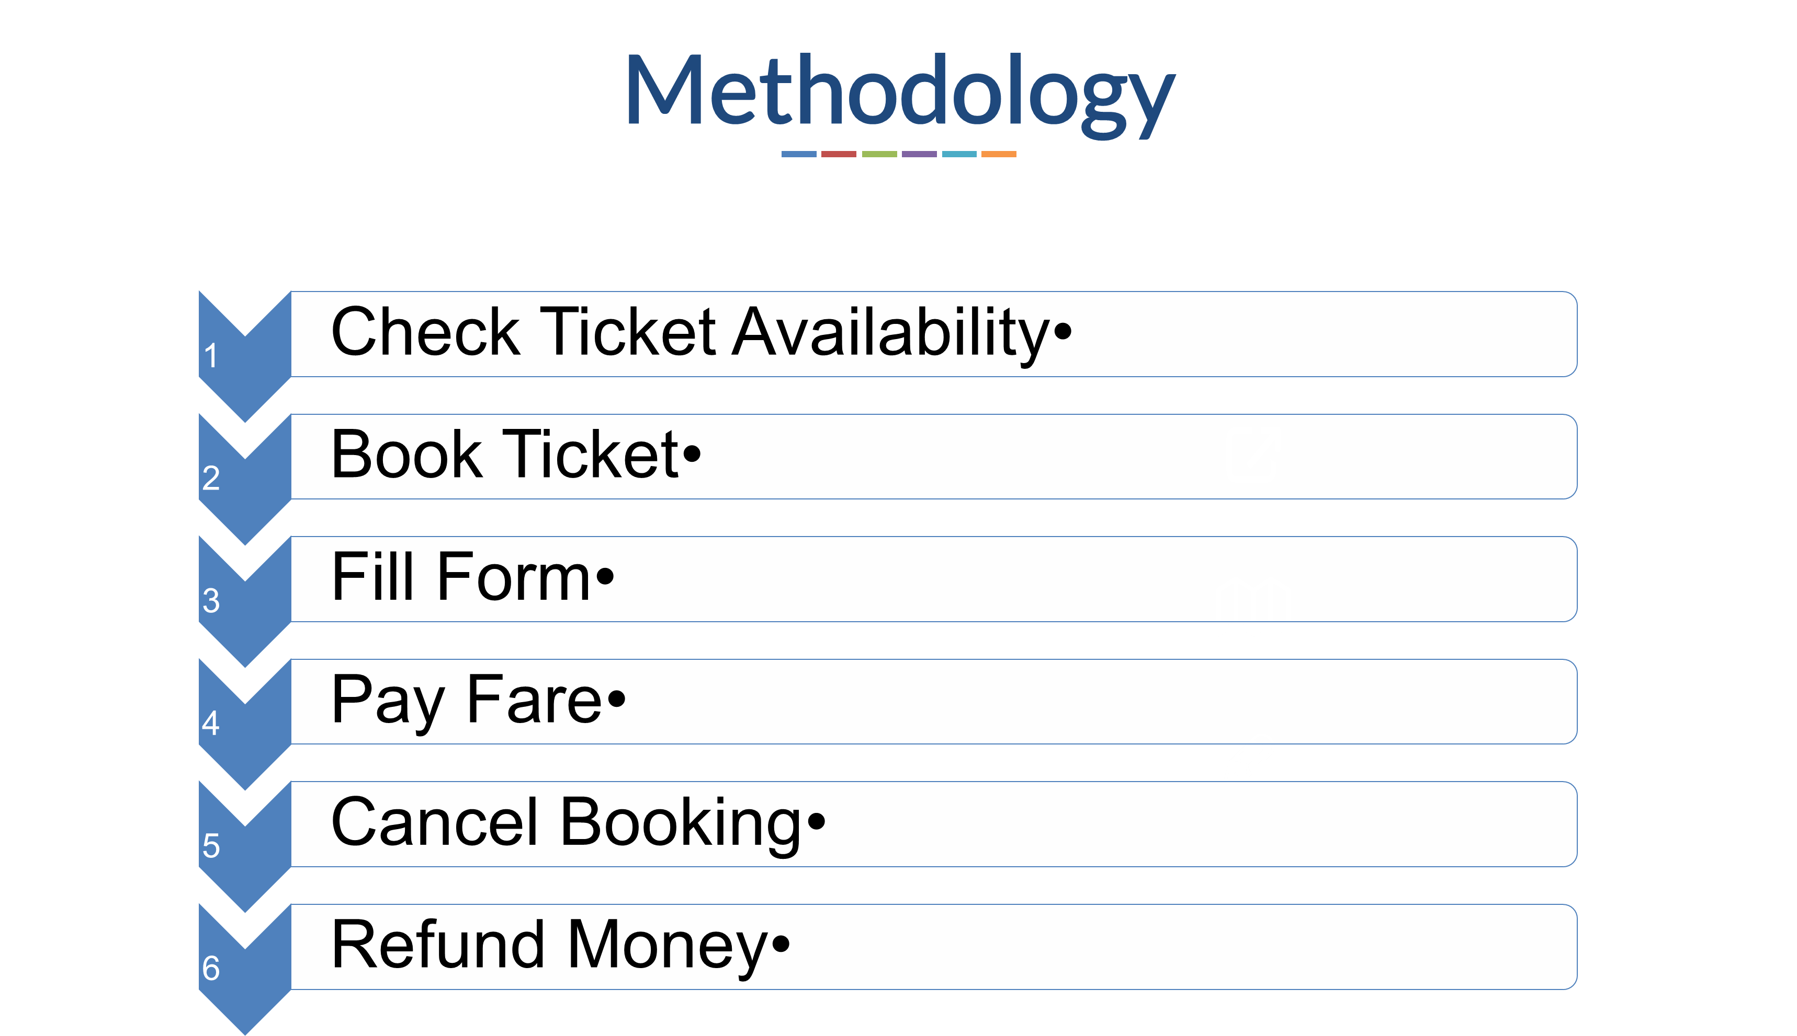
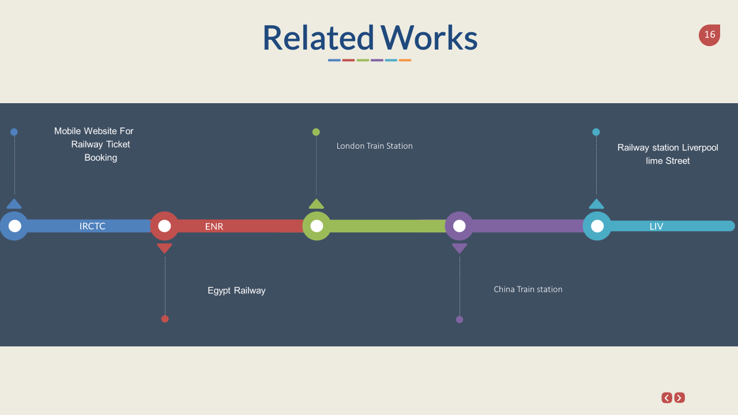
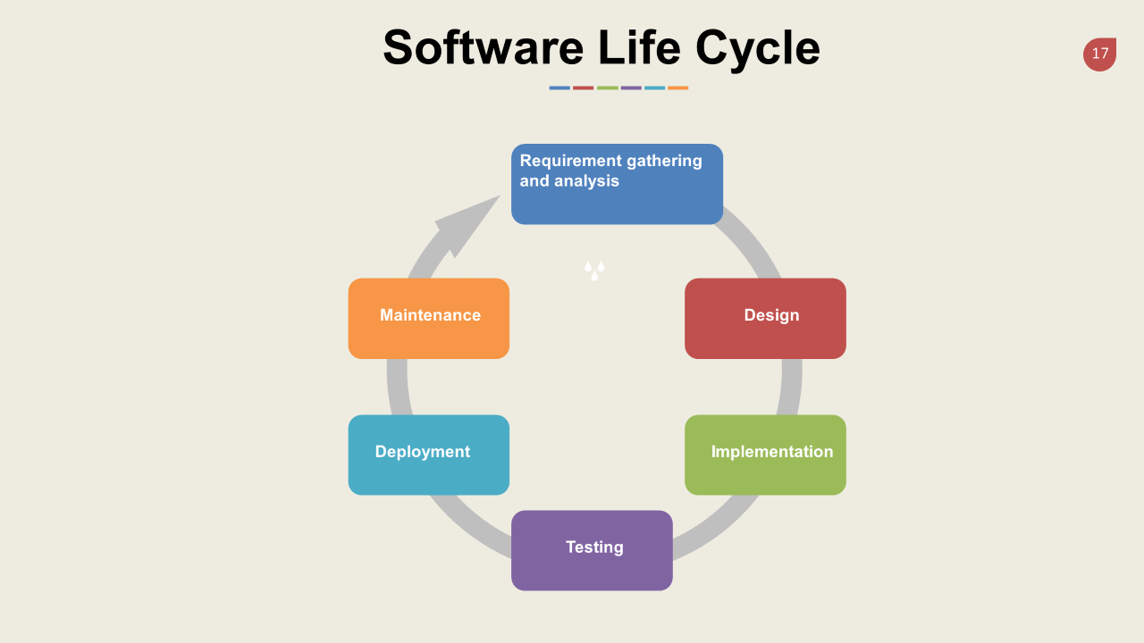
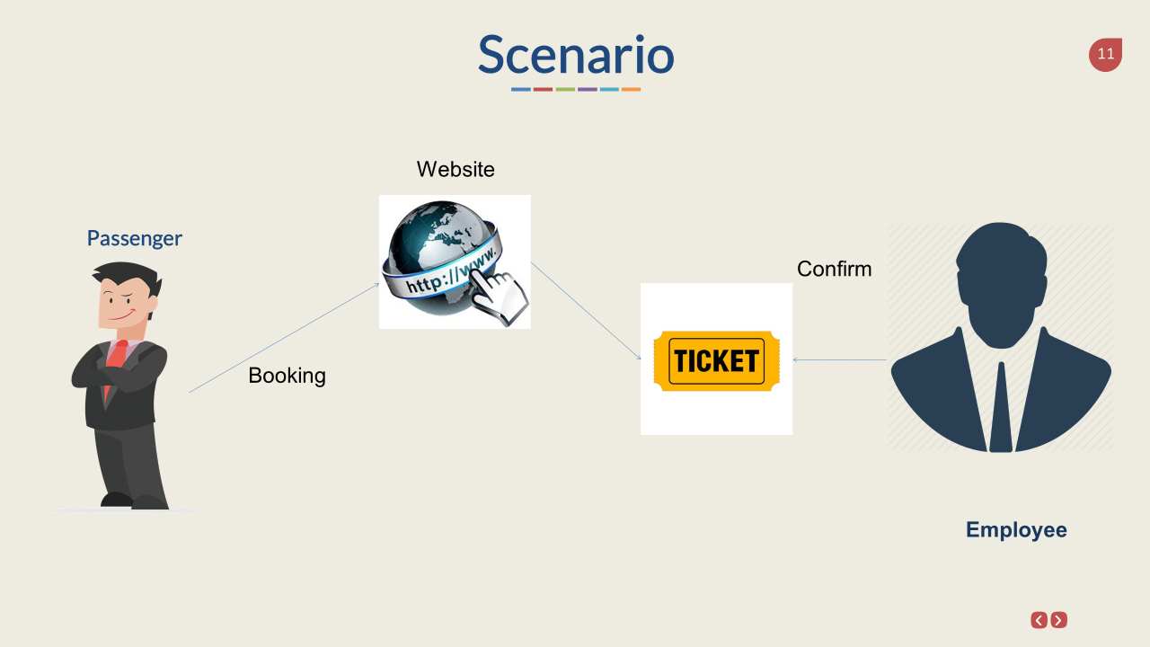

Slide 5
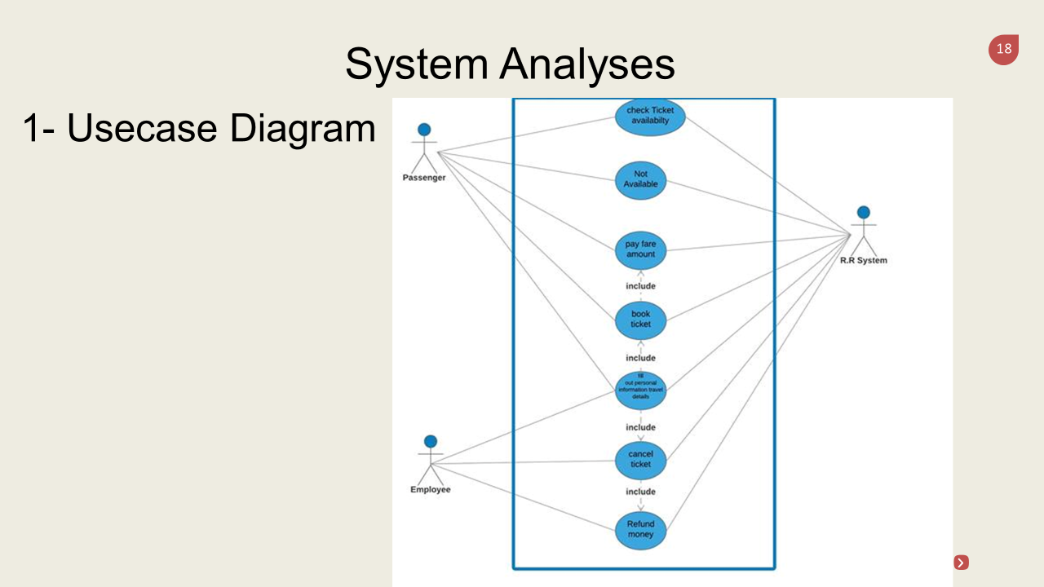

Slide 6
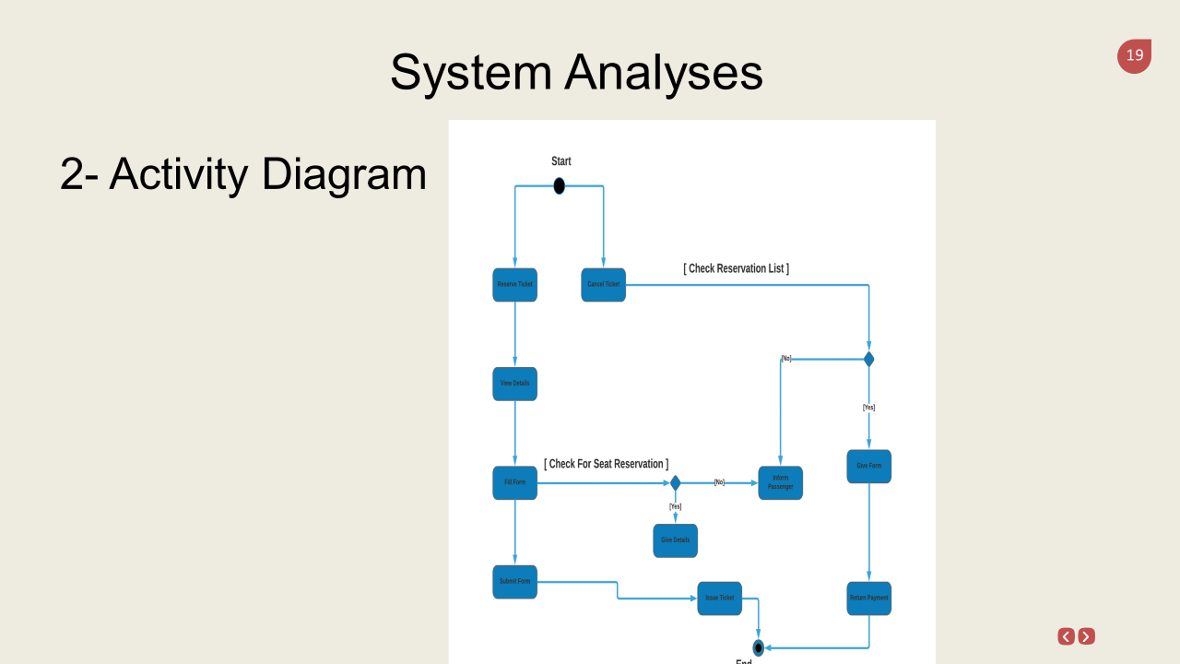

Slide 7
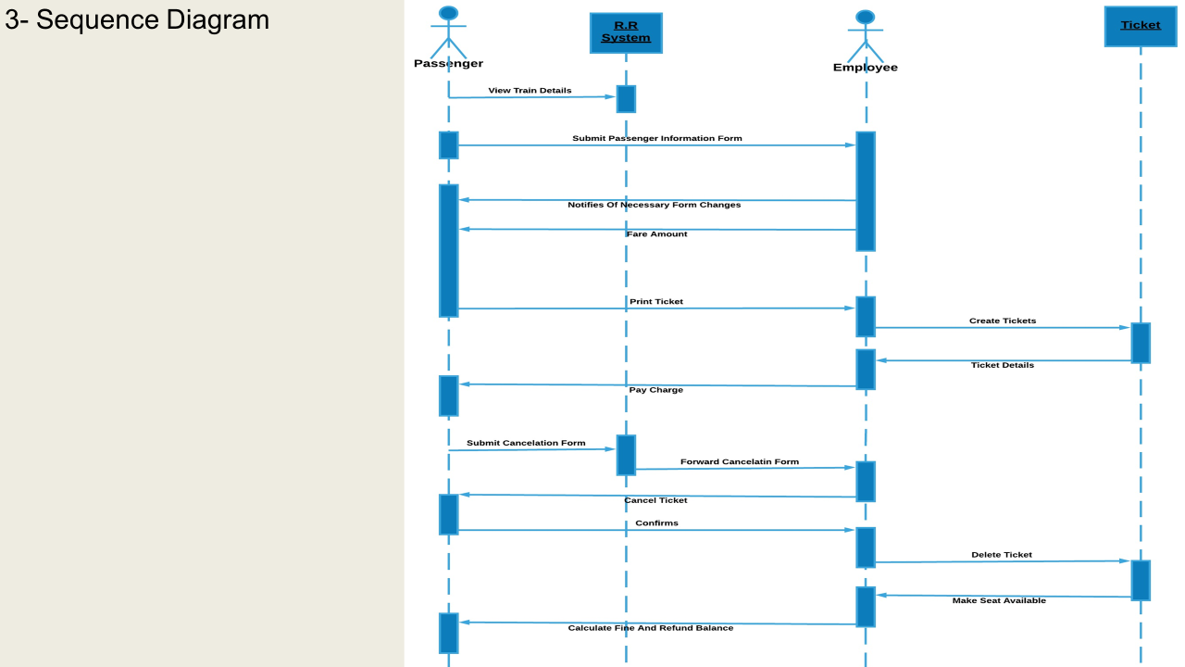

Slide 8
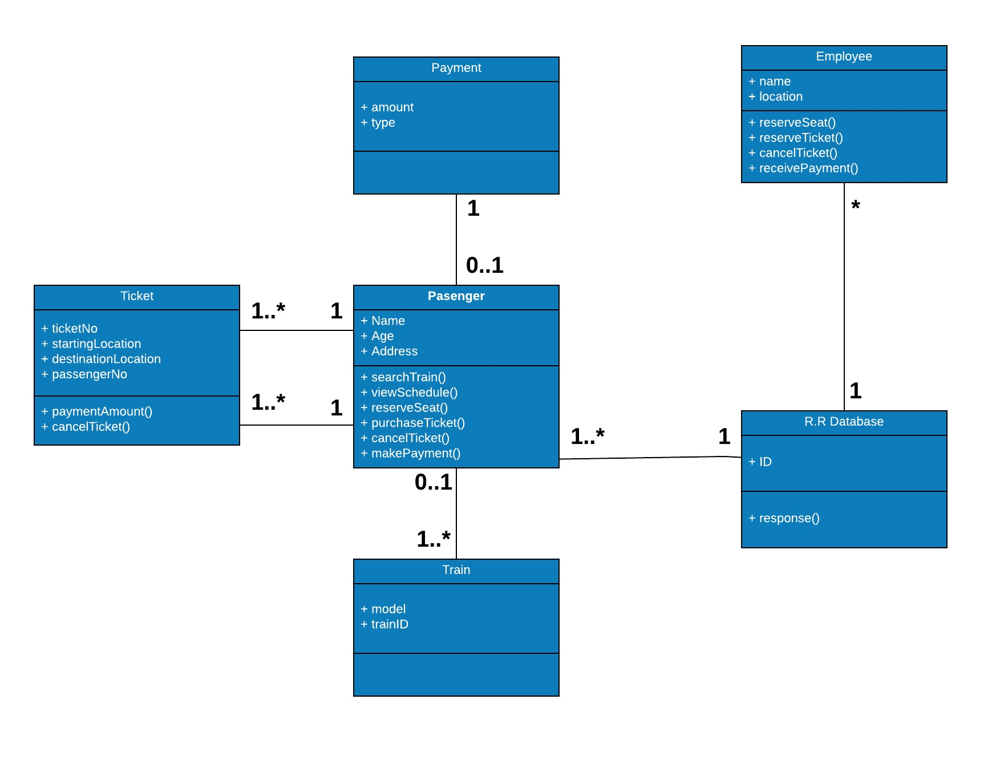
System Analyses
4- Class Diagram

Slide 9
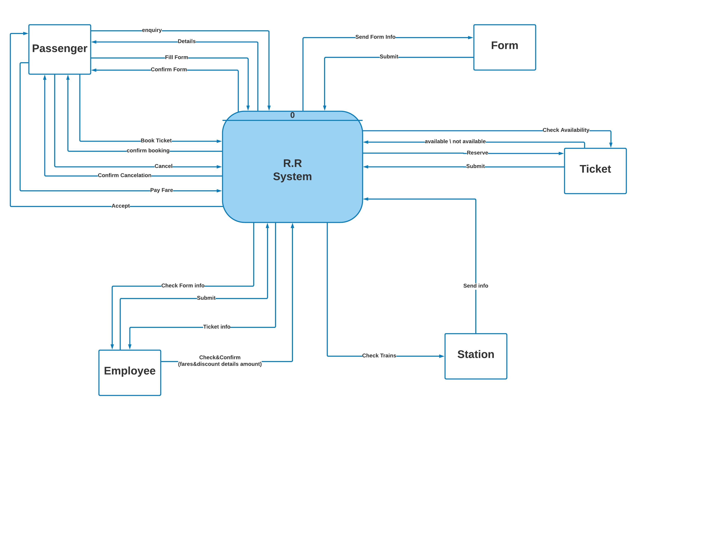
5- Dataflow Diagram
5.1 Context Diagram

Slide 10
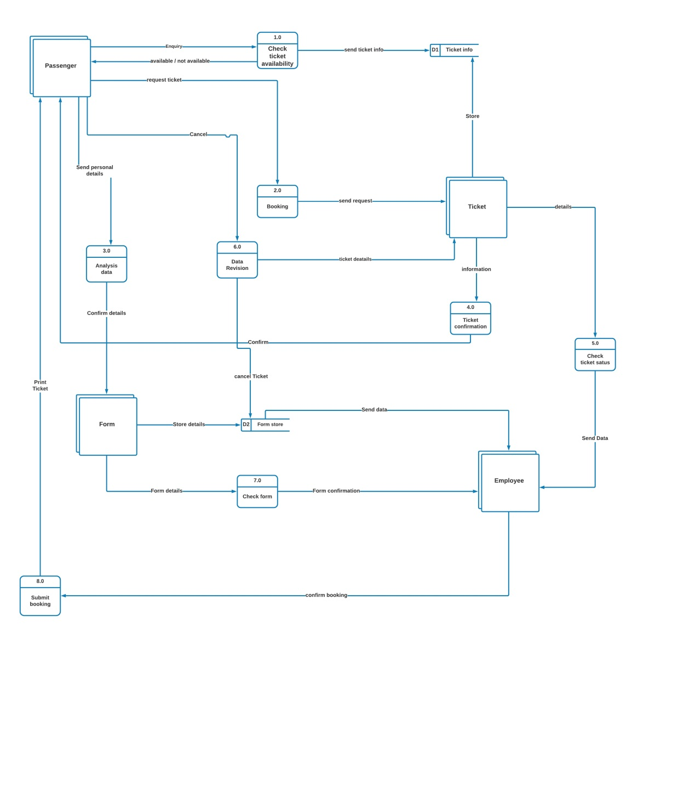
5.2 DFD Level 0

Slide 11
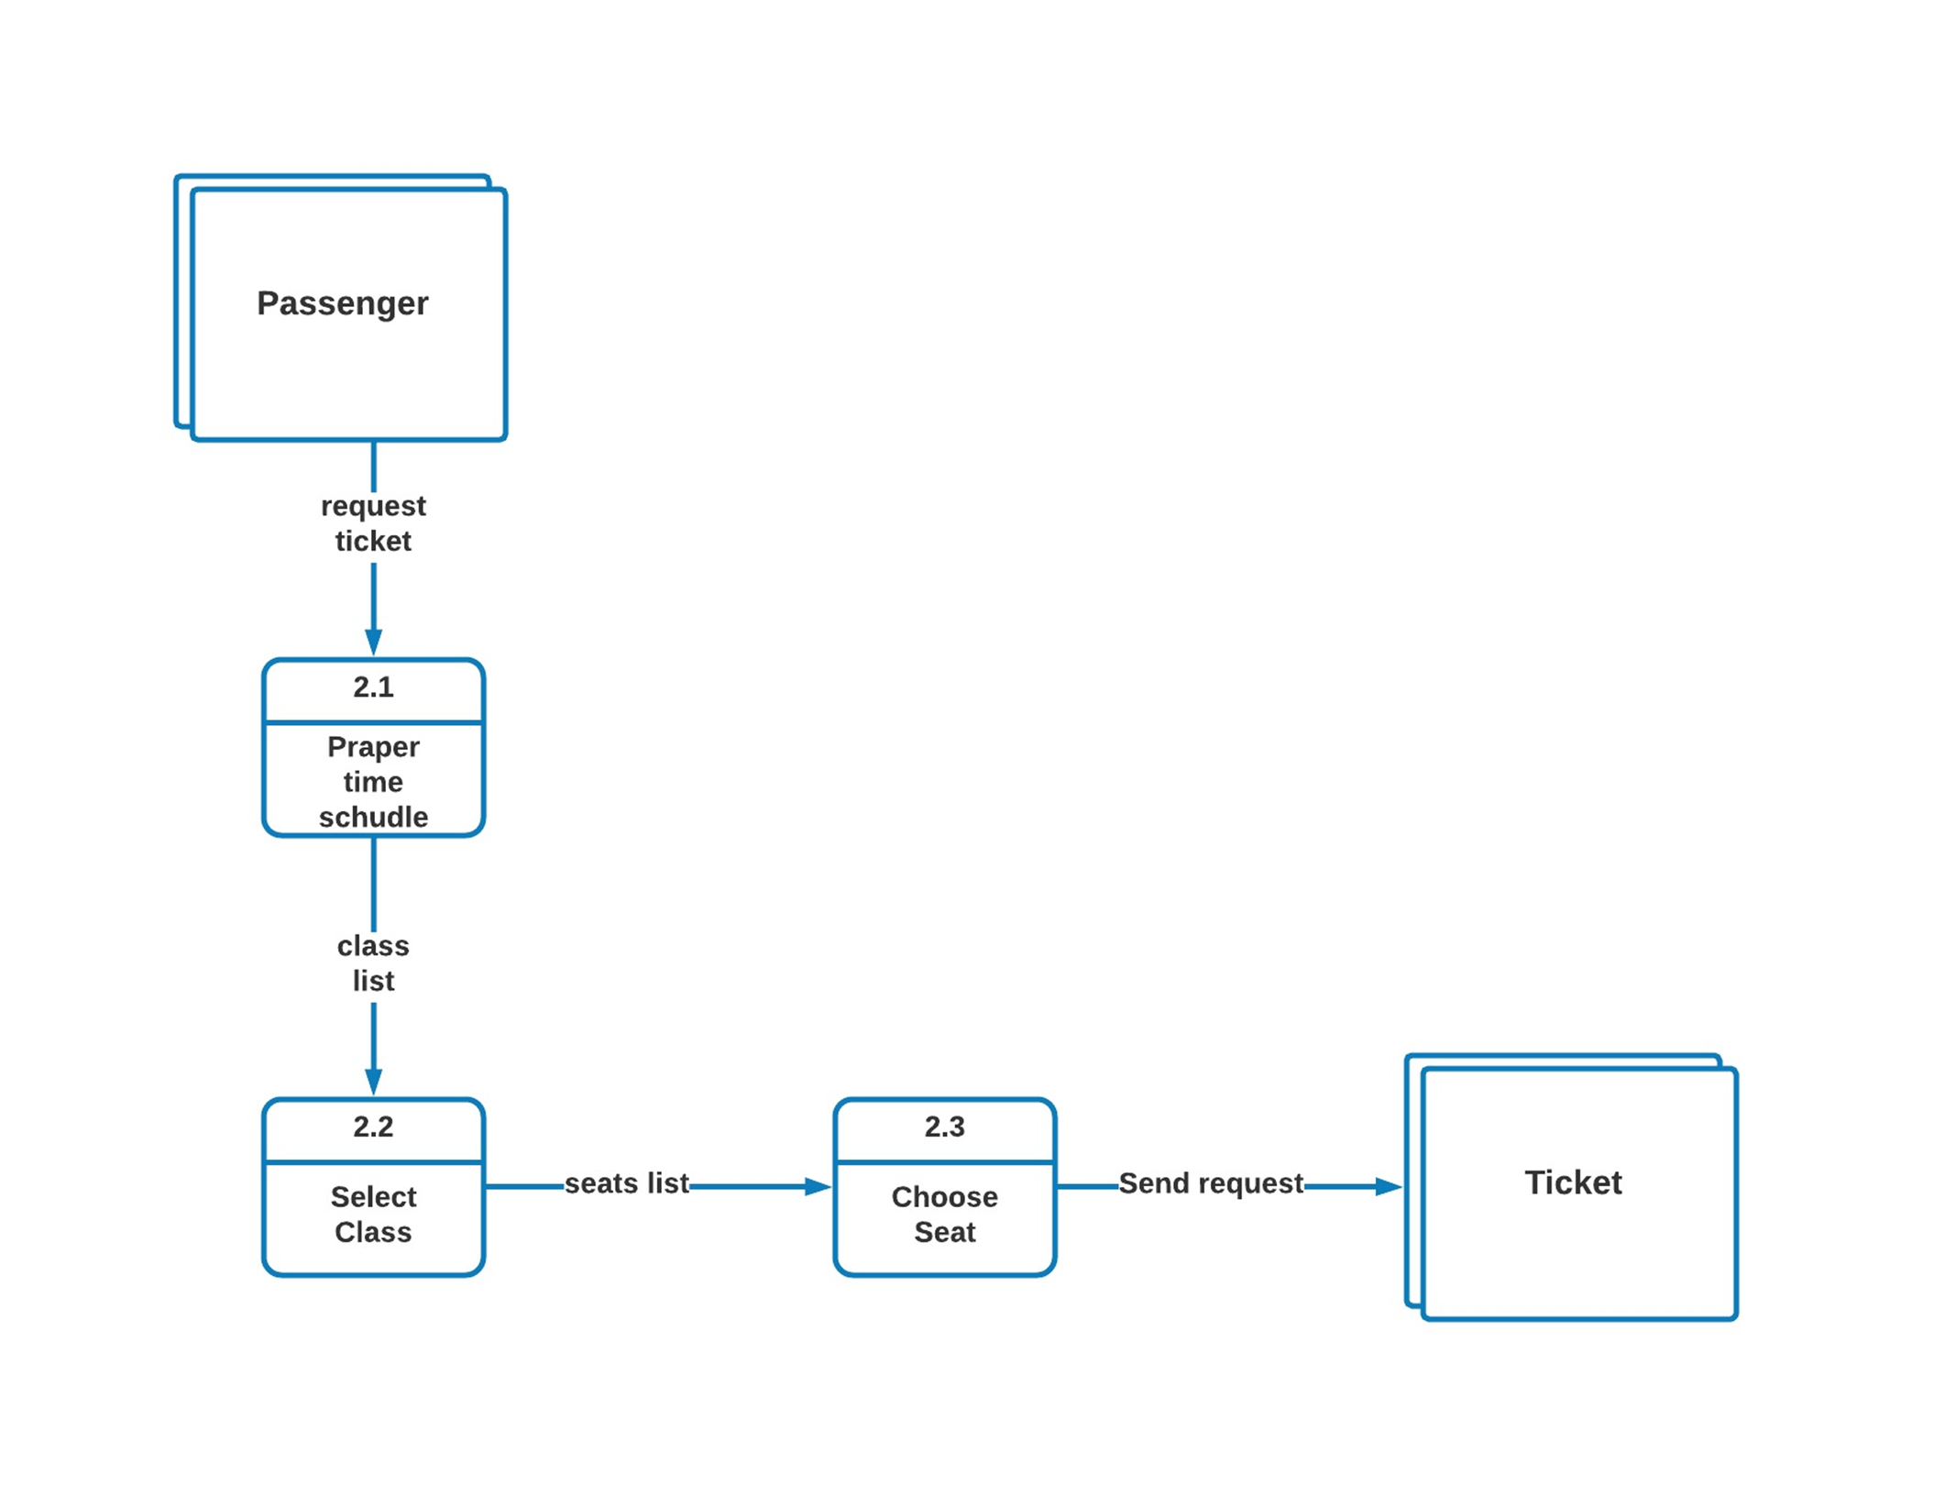
5.2 DFD Level (1 of 3)

Slide 12
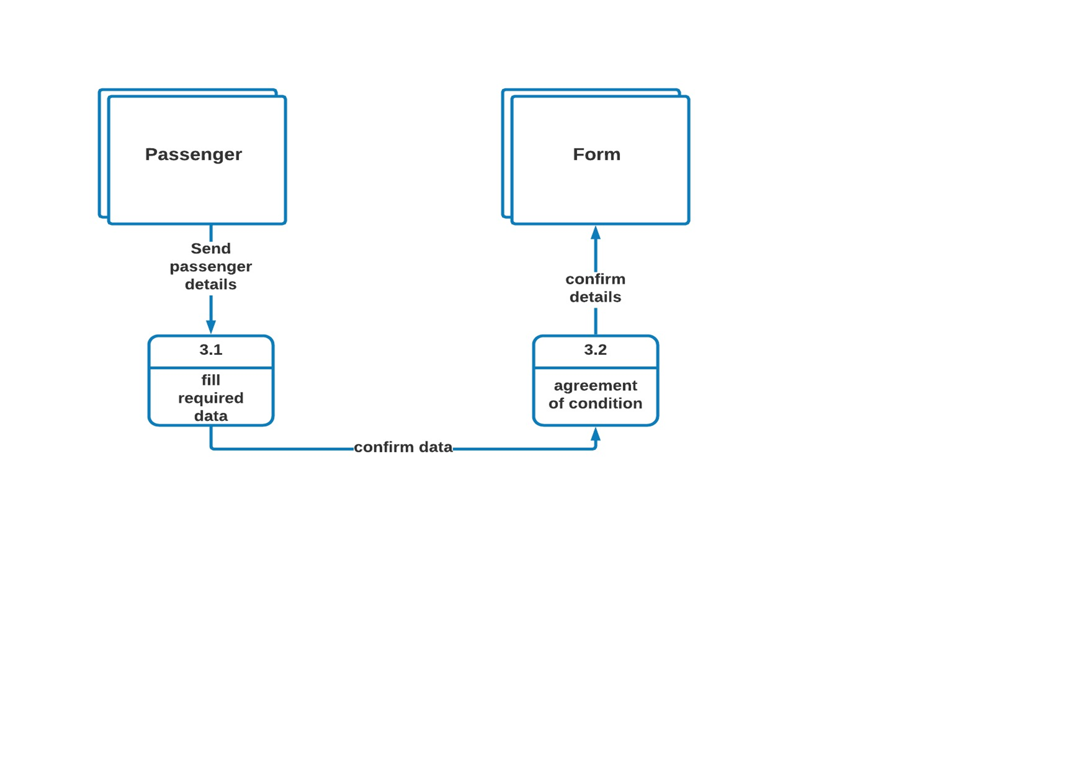
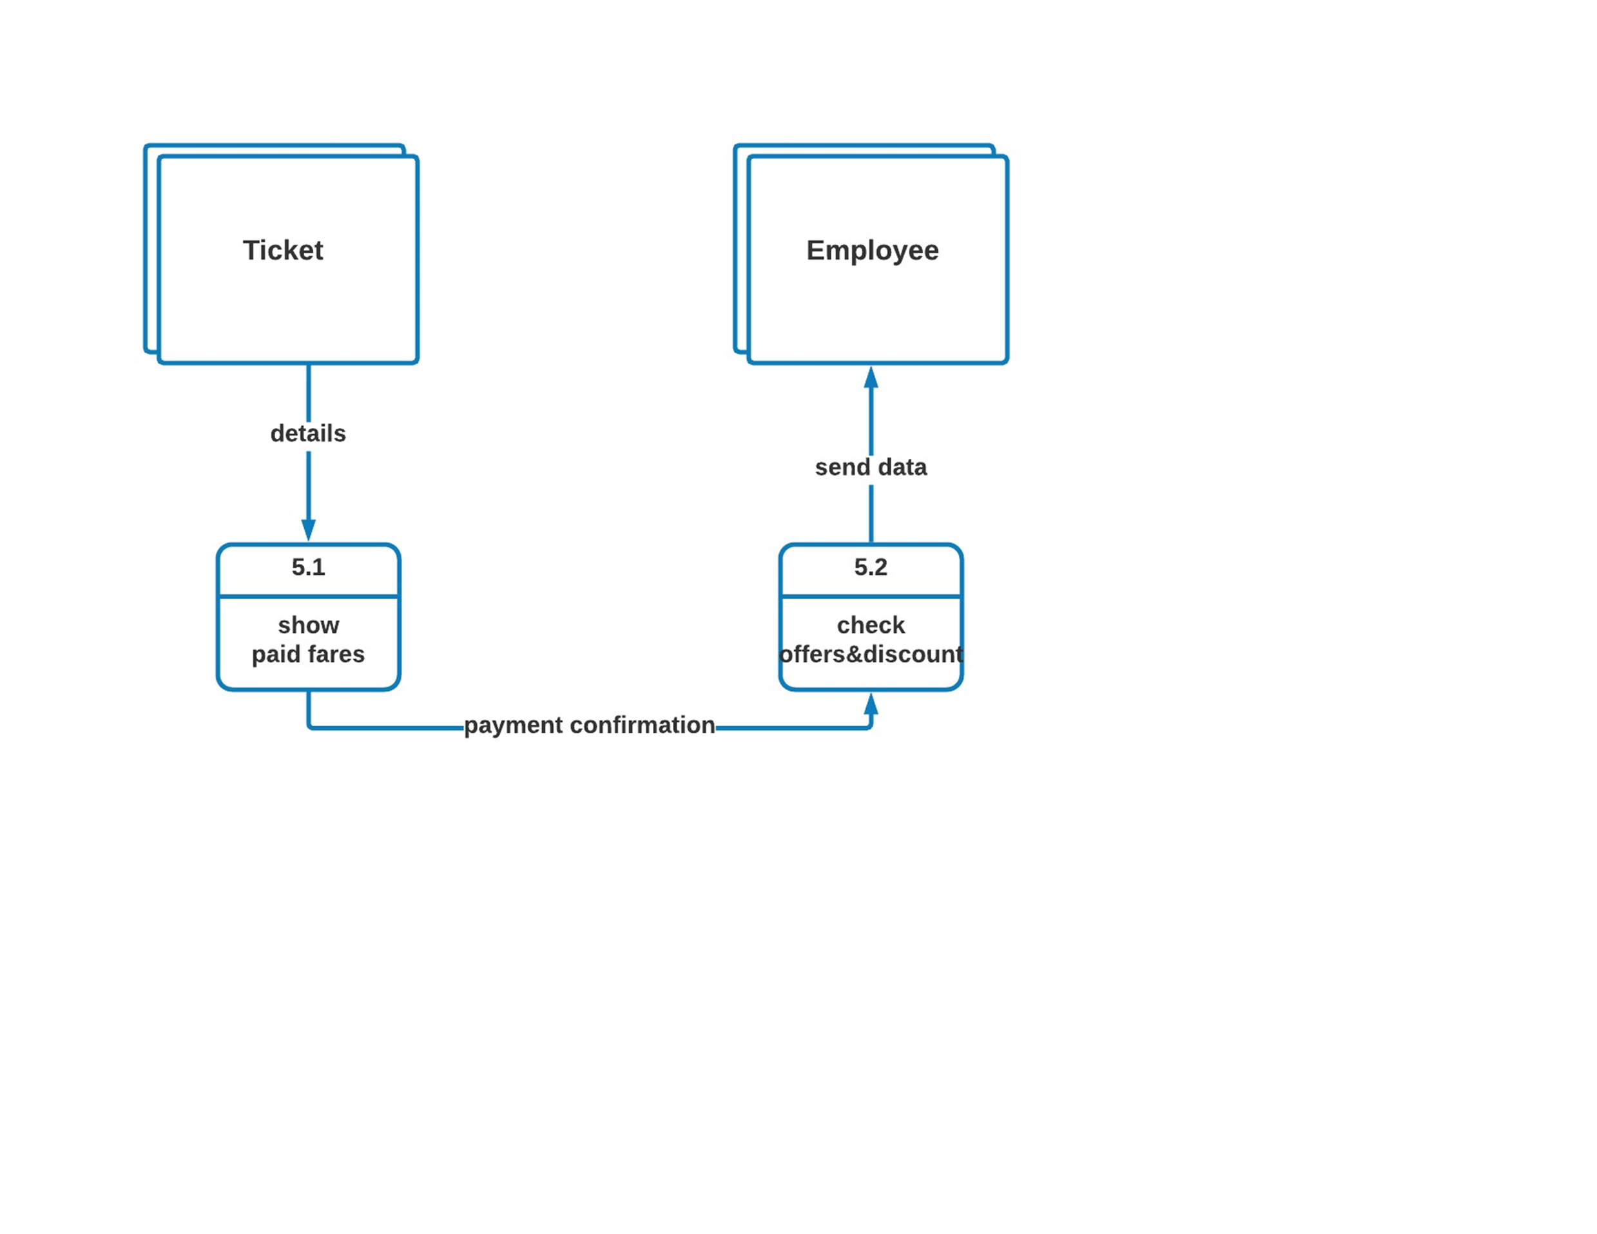
5.2 DFD Level (2 of 3)

